Slide 1
Teaching an out of date system an up to date code
Kayla Haberman & Harrison Hall

Slide 2

What's the goal?
Analyze organoid data using 2023 code – inaccessible to ChatGPT3.5
Recreate a deep learning model (Park et al 2023)
Teach ChatGPT a custom organoid analysis code, then have ChatGPT build a custom script for something similar

Slide 3
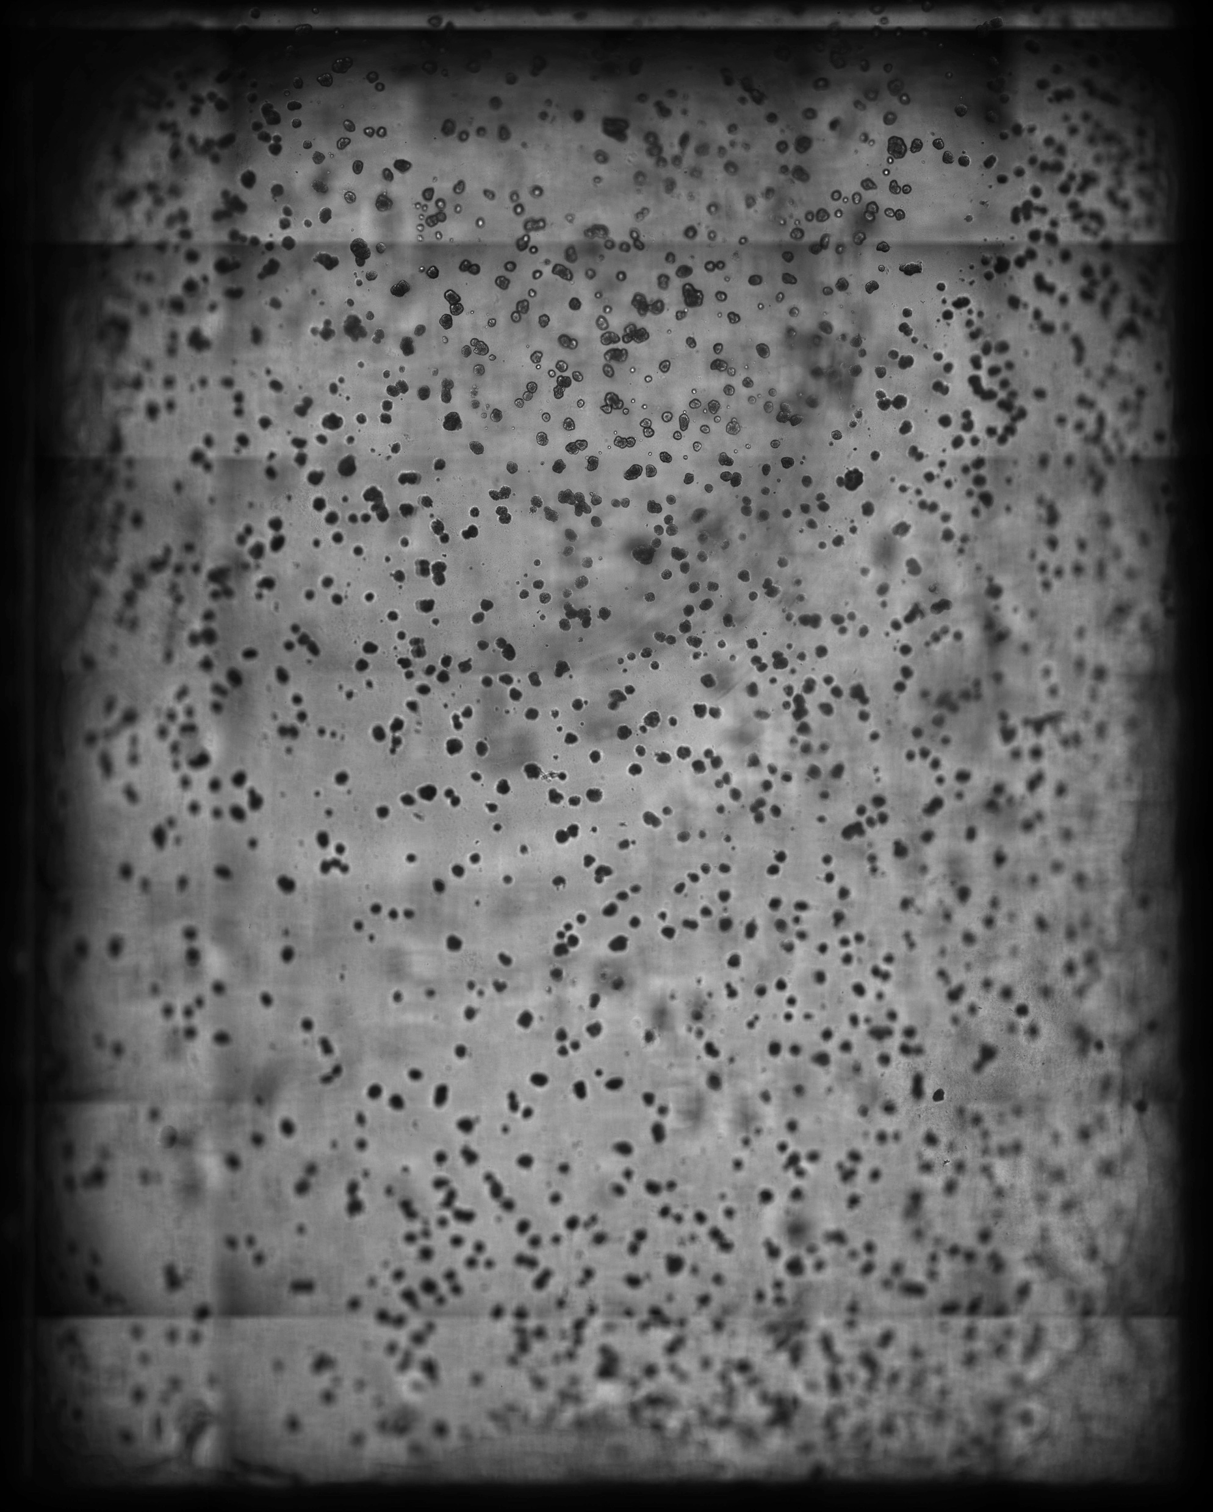
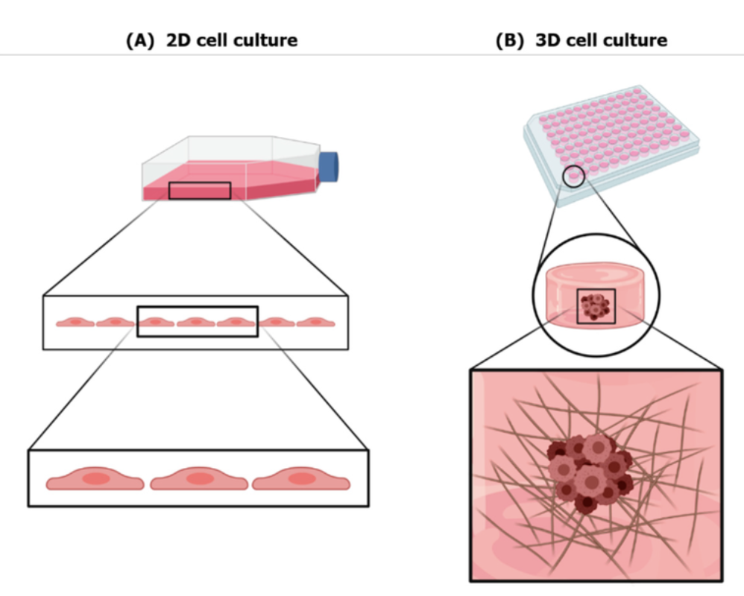
What's an organoid?
Biomaterials for Three-Dimensional Cell Culture: From Applications in Oncology to Nanotechnology - Scientific Figure on ResearchGate. Available from: https://www.researchgate.net/figure/2D-vs-3D-cell-culture-A-Cell-behavior-in-2D-conventional-cell-culture-Cells-cultured_fig1_349301450 [accessed 30 Apr, 2024]

Slide 4
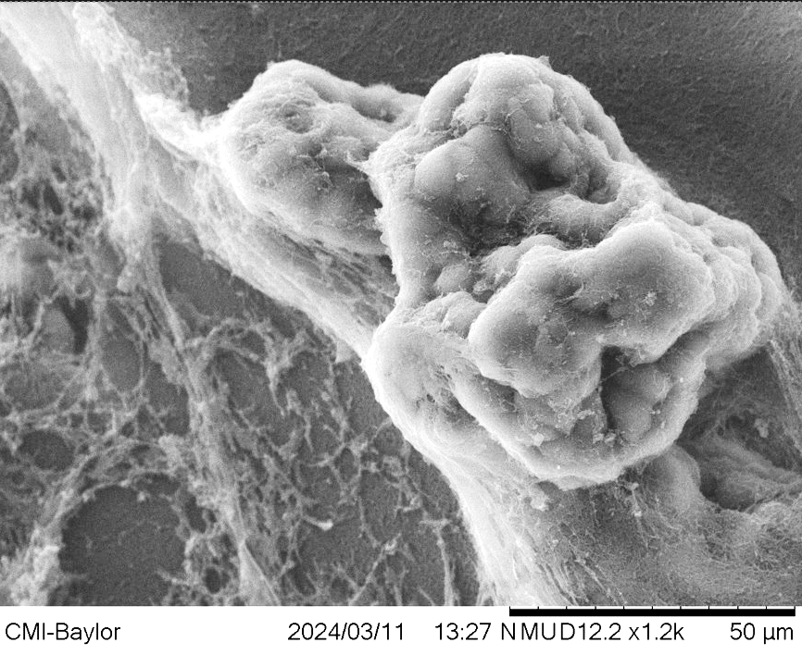
What's an organoid?

Slide 5
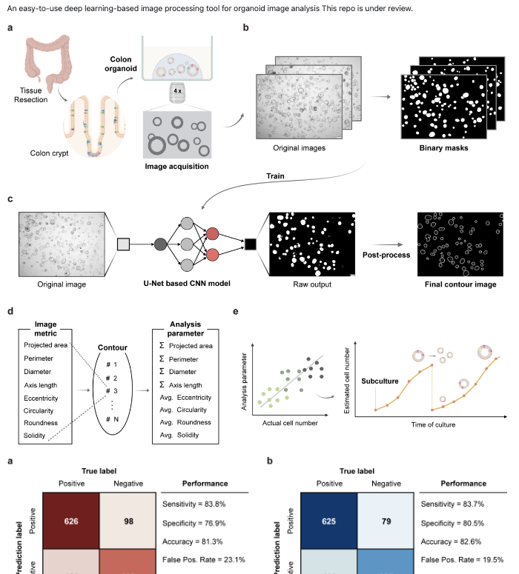
What are we basing our work on?
Park et al 2023
Code accessible in GitHub
Link to Collab Google for unexperienced users

Slide 6
Theoretical Workflow
Teaching:
Hey ChatGPT, this code analyzes organoids, and this is how you use it.
Verifying Learning:
Hey ChatGPT, can you explain to me how this code works?
Using the Code:
Hey ChatGPT, can you make me a code that lets me analyze an organoid image and outputs a graph of the result?

Slide 7
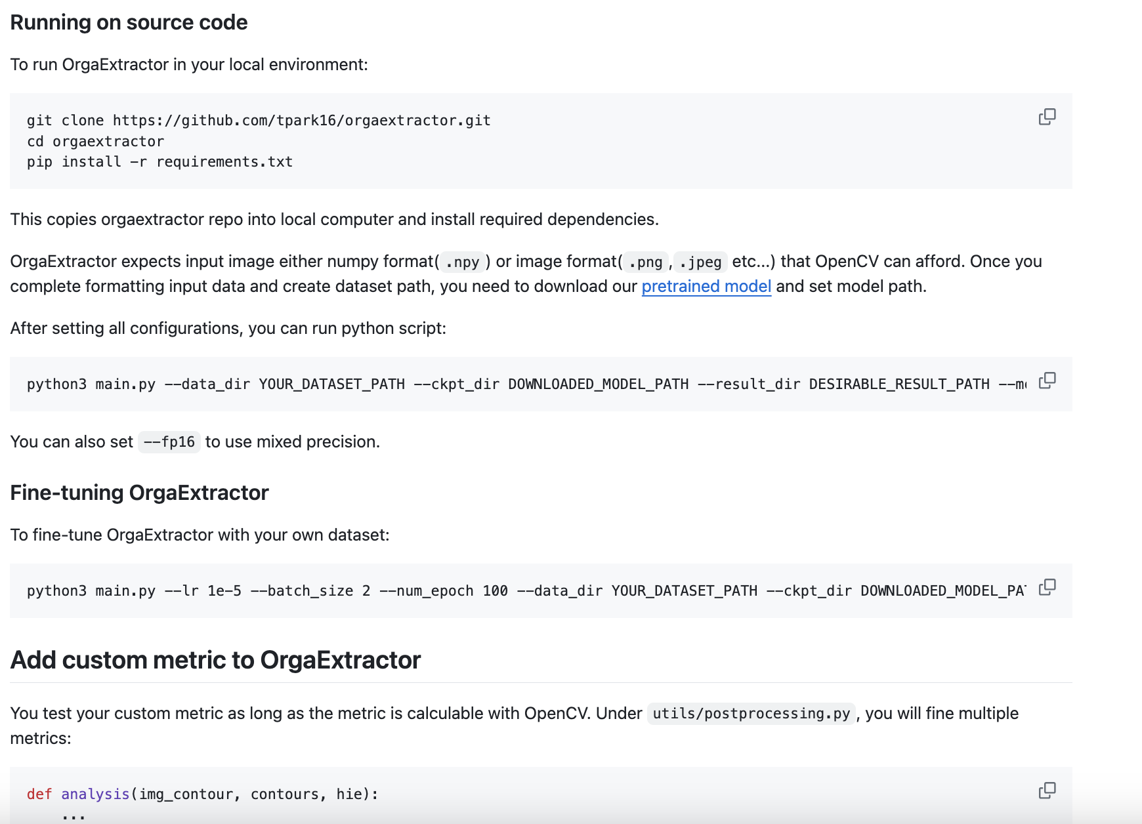
Step 1: Obtain a functional Code
KH
Now let’s recreate and transform
HH

Slide 8
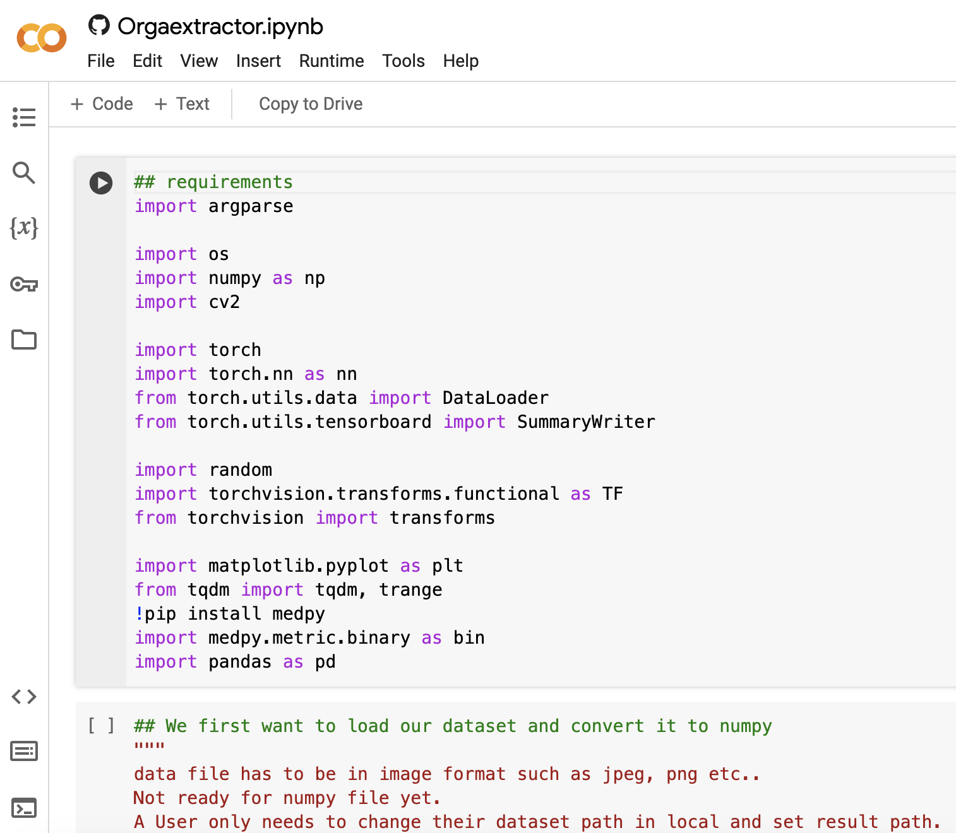
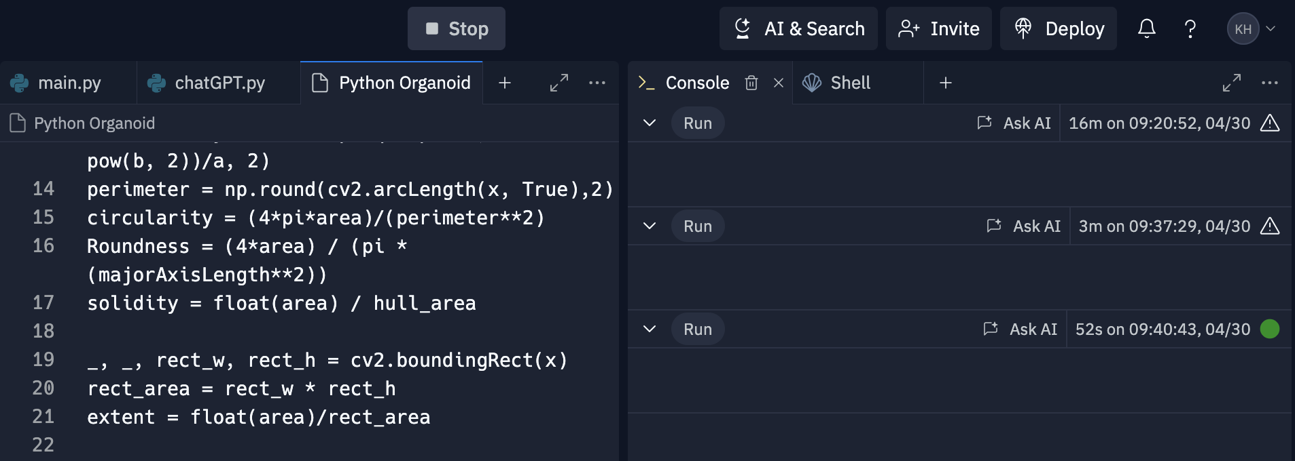
Step 2: Running the Original Code
KH
Using Replit
Slow process due to large file size
Using Google Collab
Issues: ​
Uploading file as a 'directory'​
Non-functional code they had was not functioning "cuda"

Slide 9
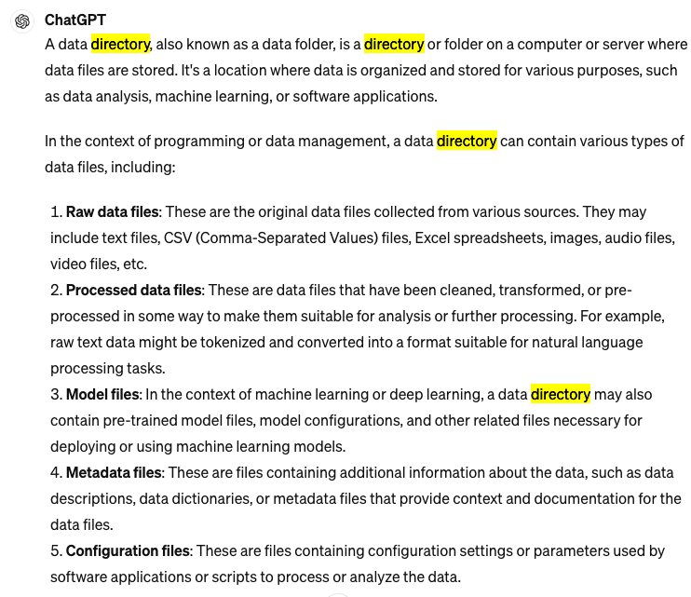
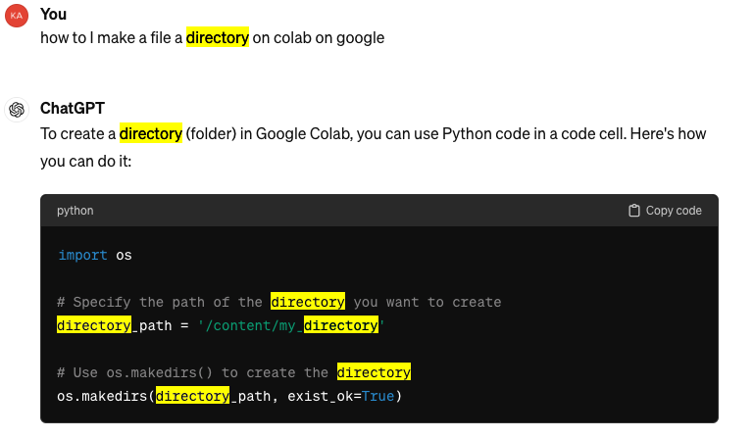
Step 2: Running the Original Code
KH
Using Google Collab
Learned what a directory is:
Using Google Collab
Learned how to create a directory

Slide 10
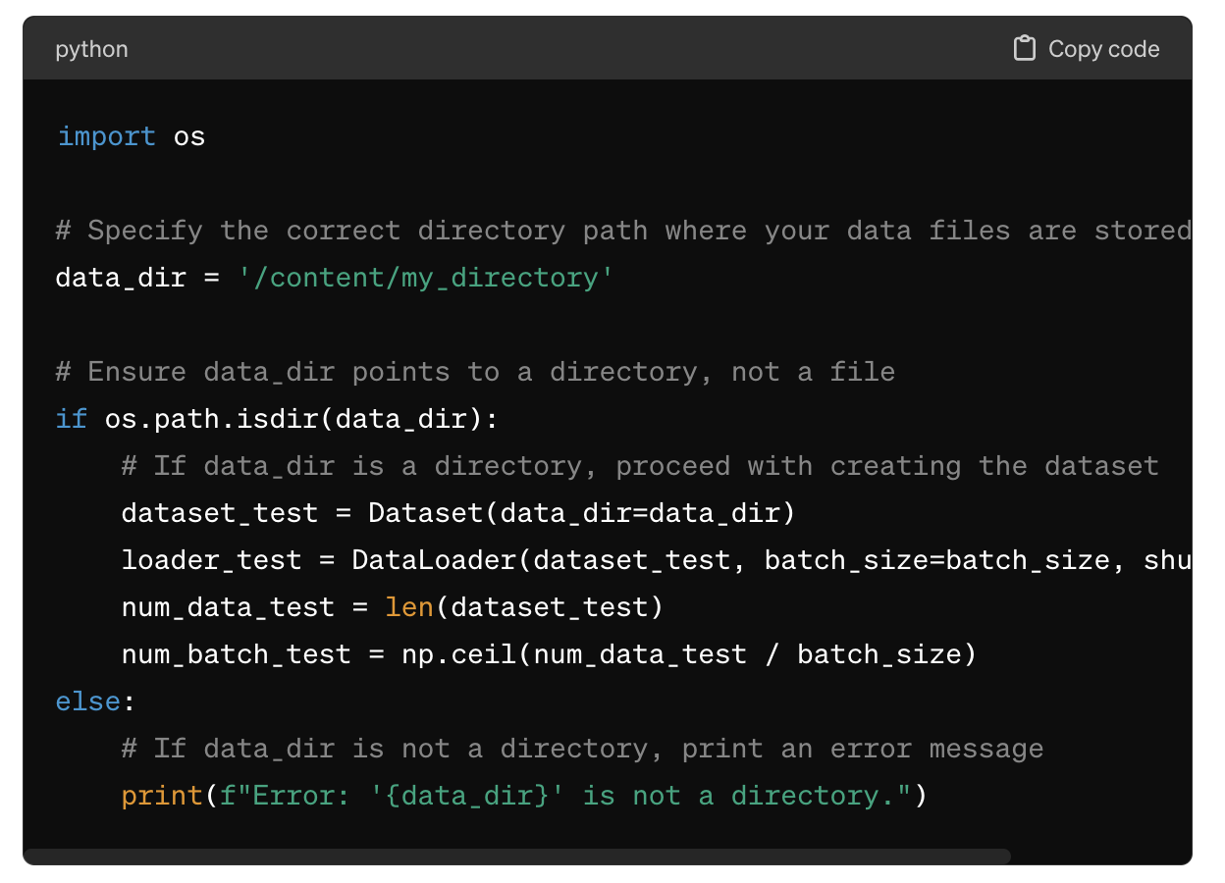
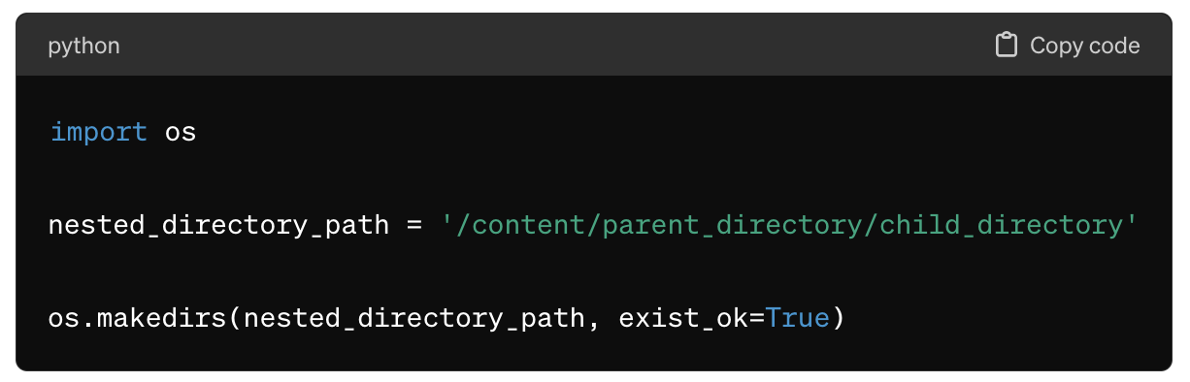
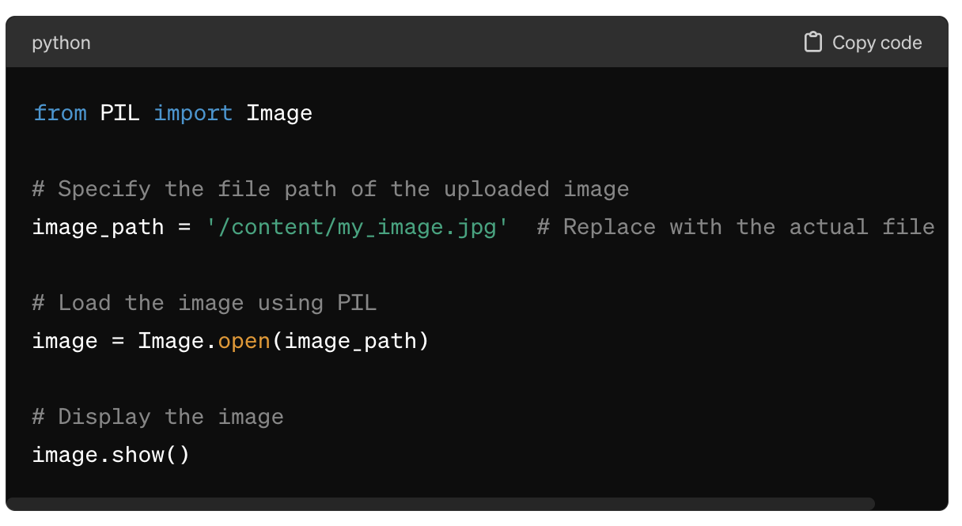
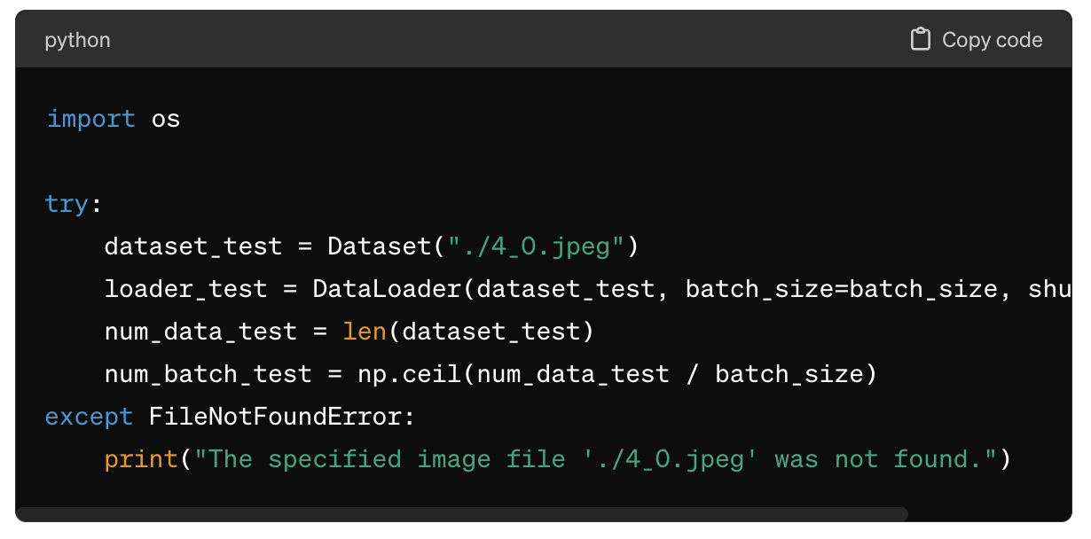
Step 2: Running the Original Code
KH
Using Google Collab
issues with directory

Slide 11
Step 2: Running the Original Code
KH
HH

Slide 12
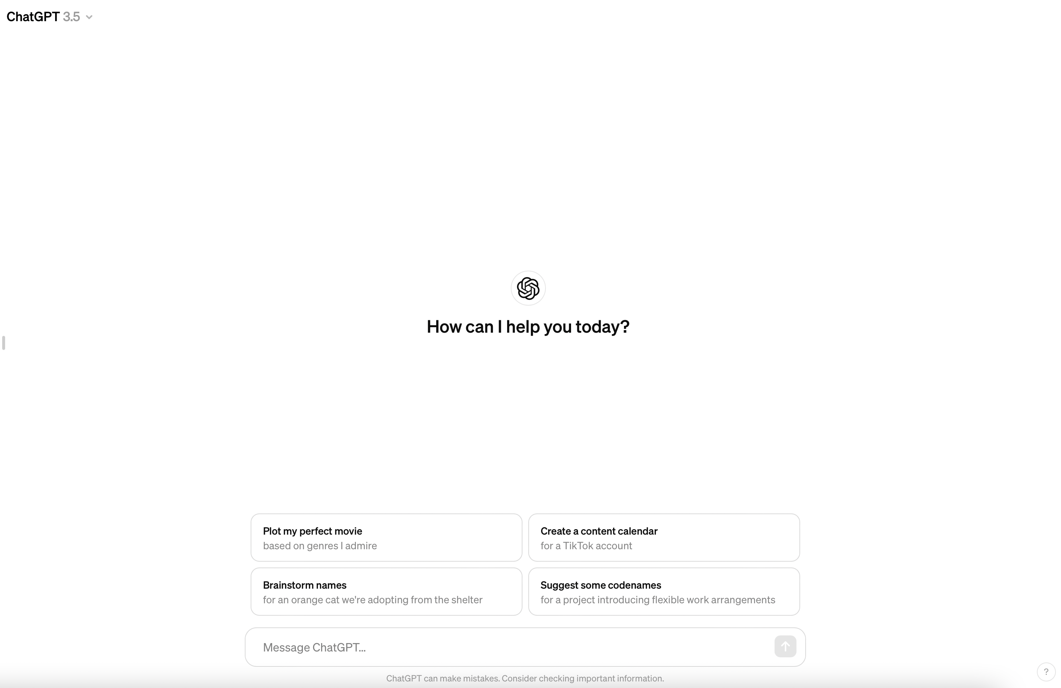


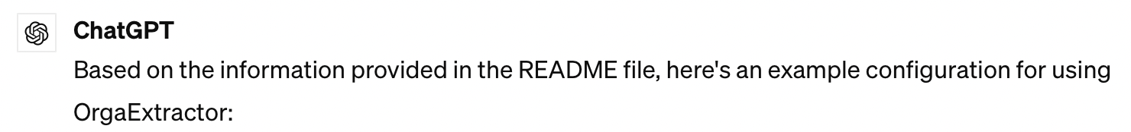


Step 2: Teaching the Code
HH

Slide 13

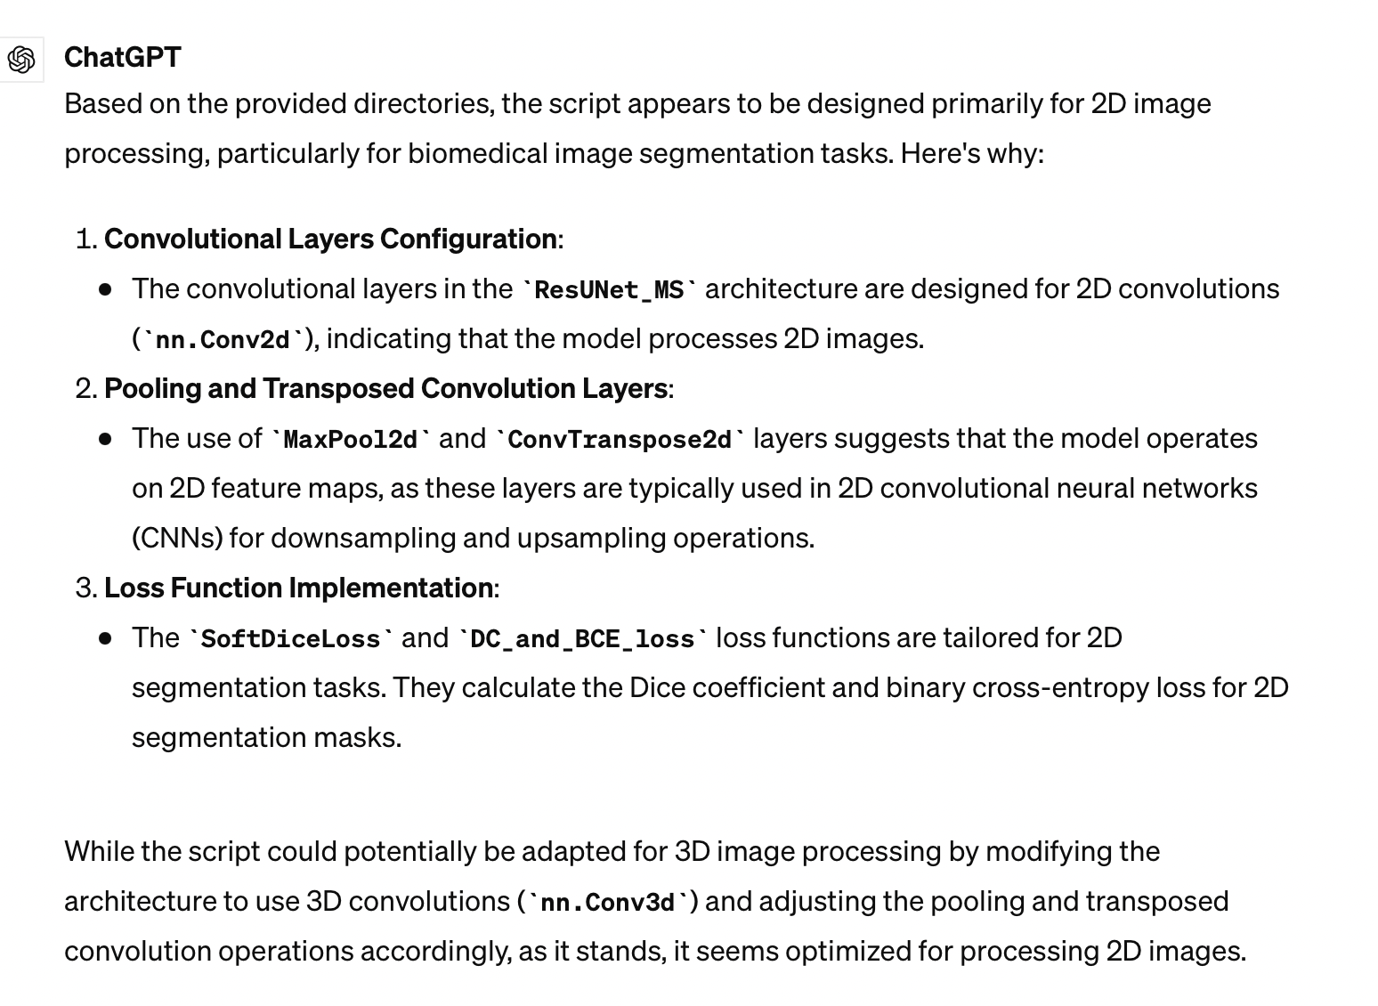
Step 2: Verifying Learning
HH

Slide 14

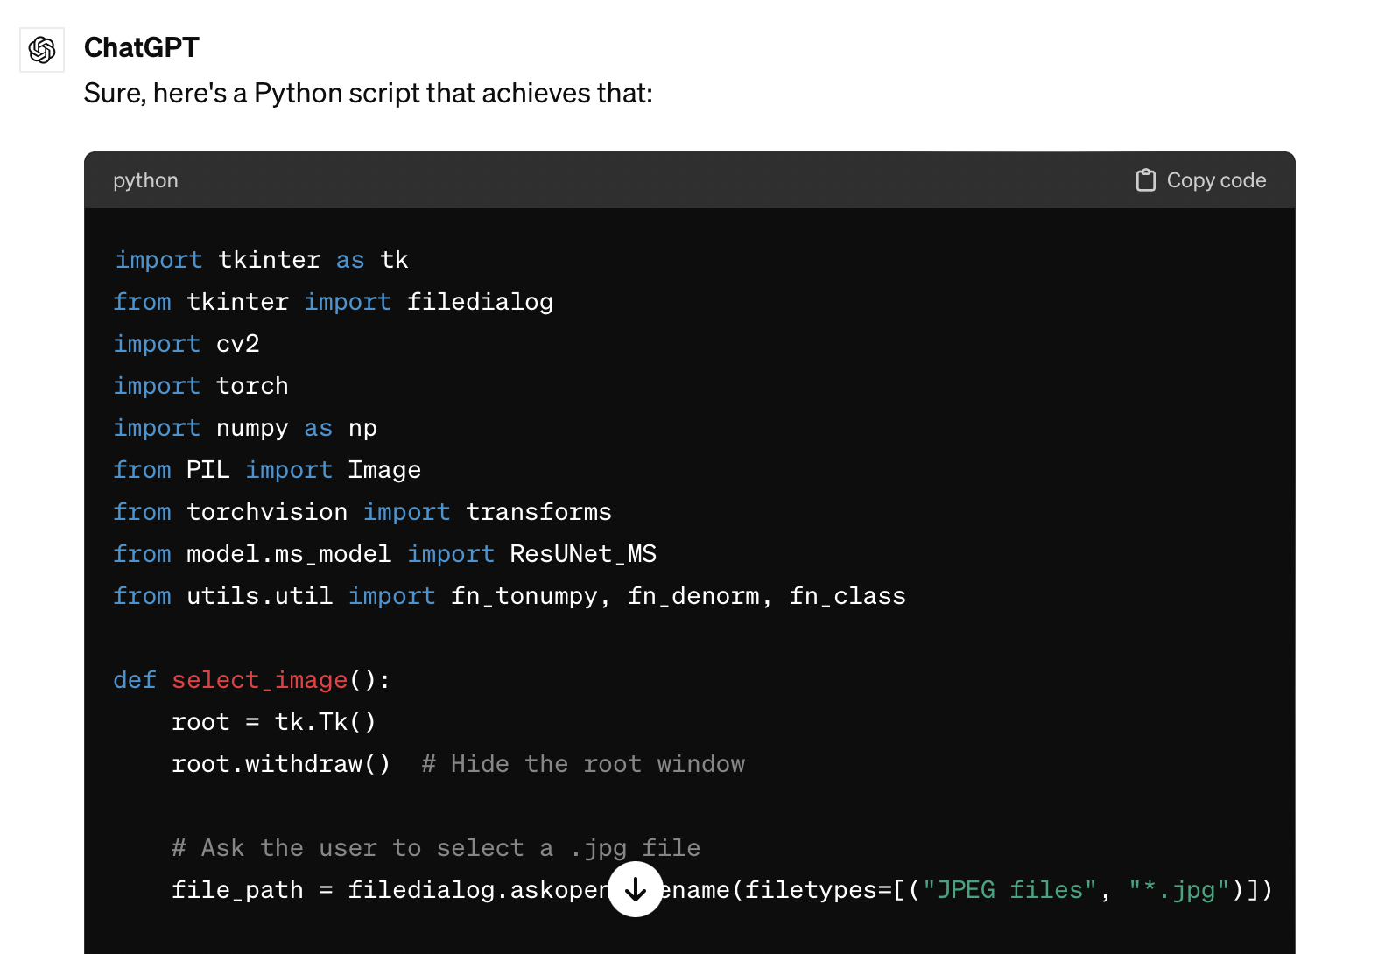
Step 3: Applying the Code
HH

Slide 15
Step 3.5: Realize It’s Python
HH

Slide 16
Step 3.6: Realize I Can’t Use Python
HH

Slide 17

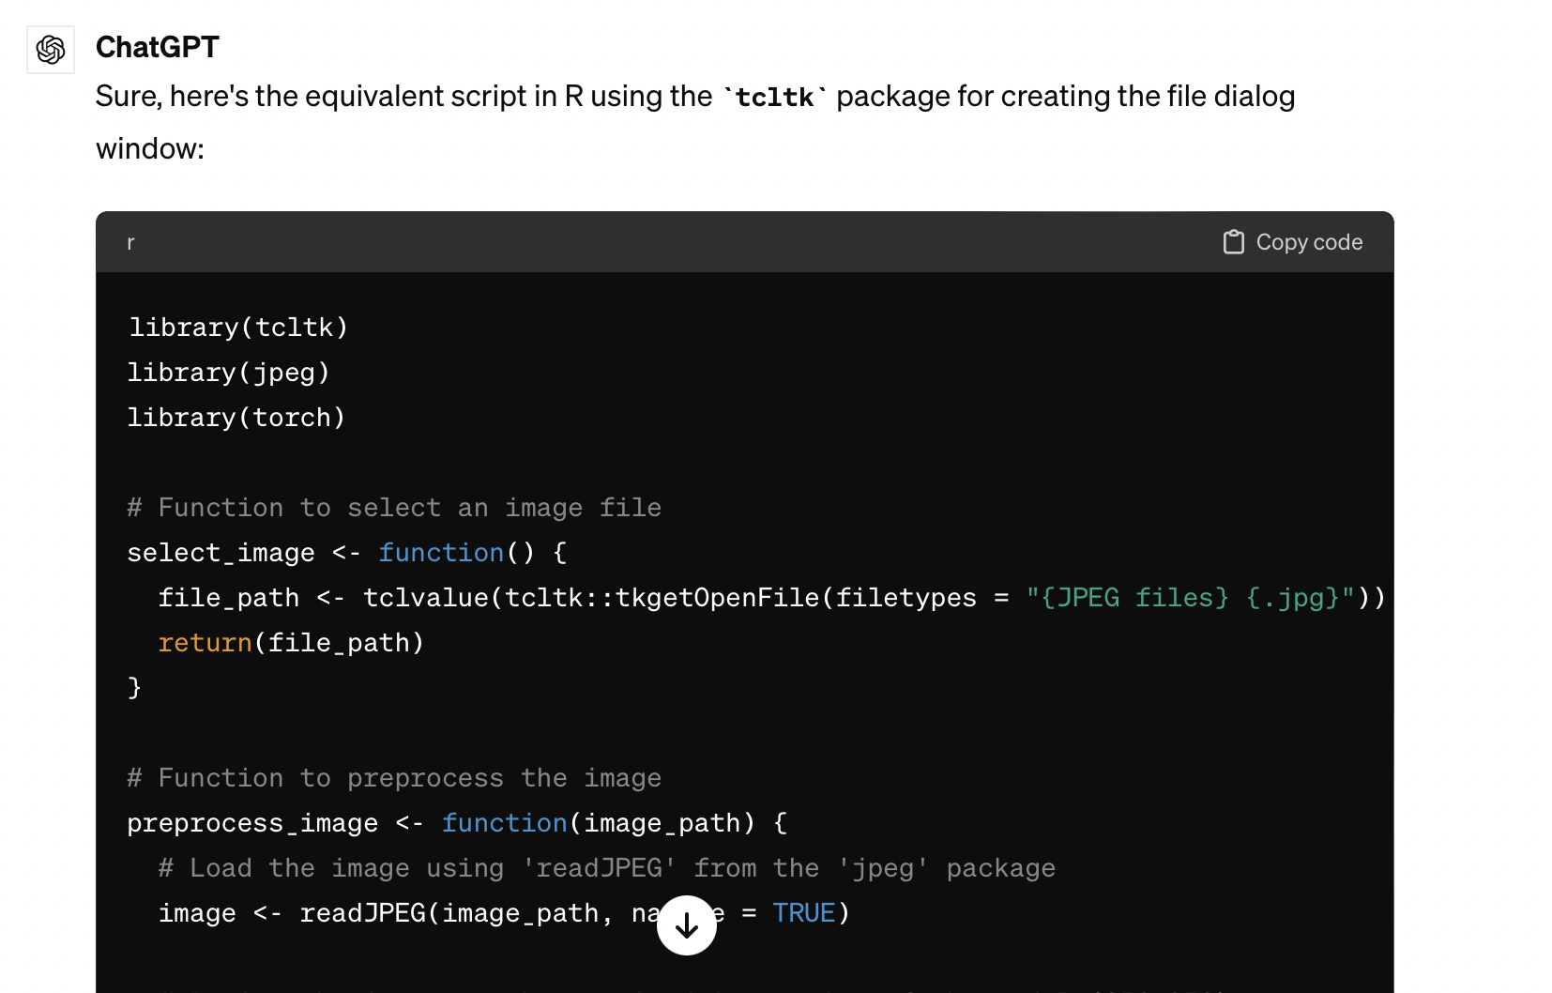
Step 4: Converting the Code
HH

Slide 18

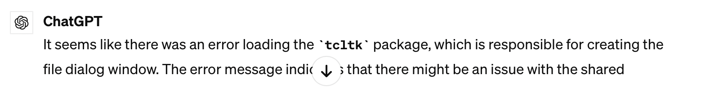
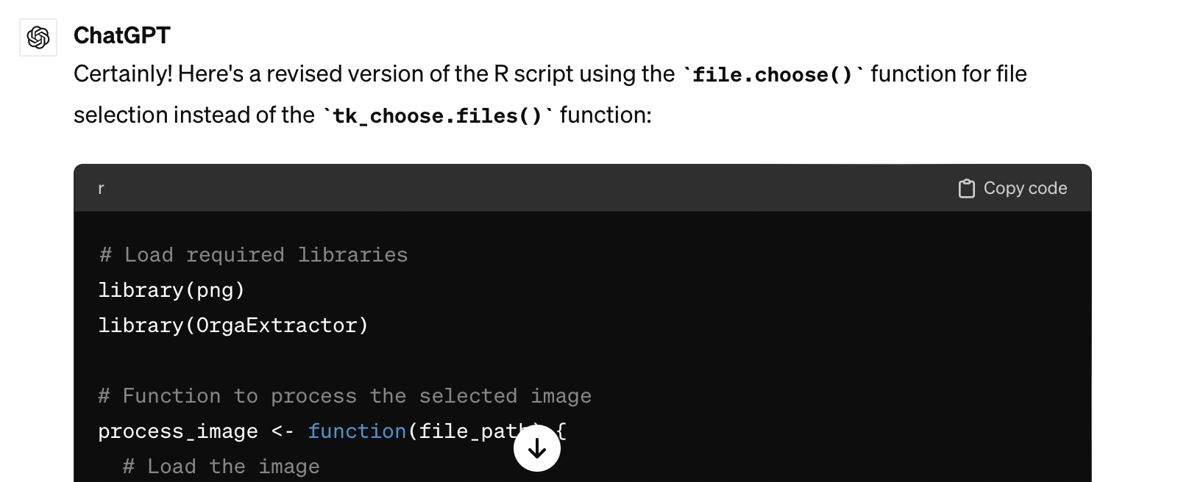
Step 4.5: Troubleshooting
HH

Slide 19

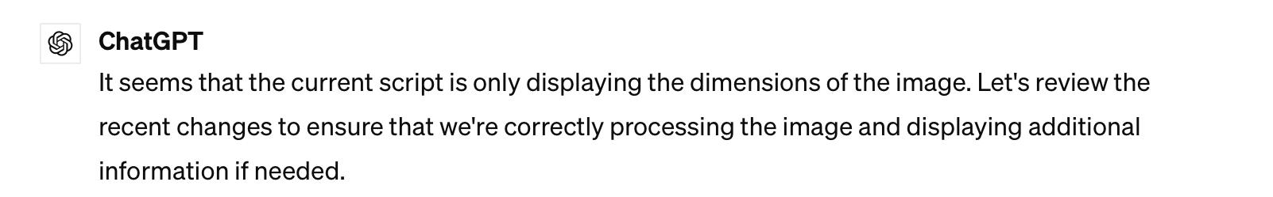
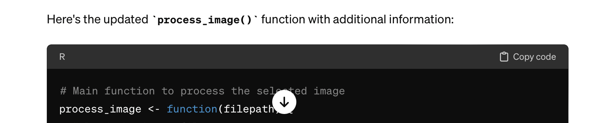

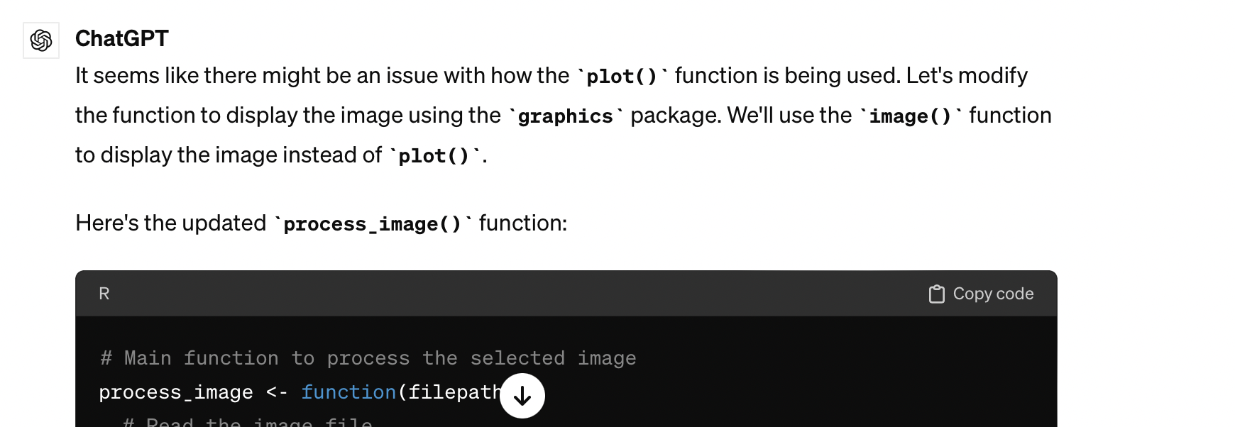
Step 4.6: Troubleshooting
HH

Slide 20
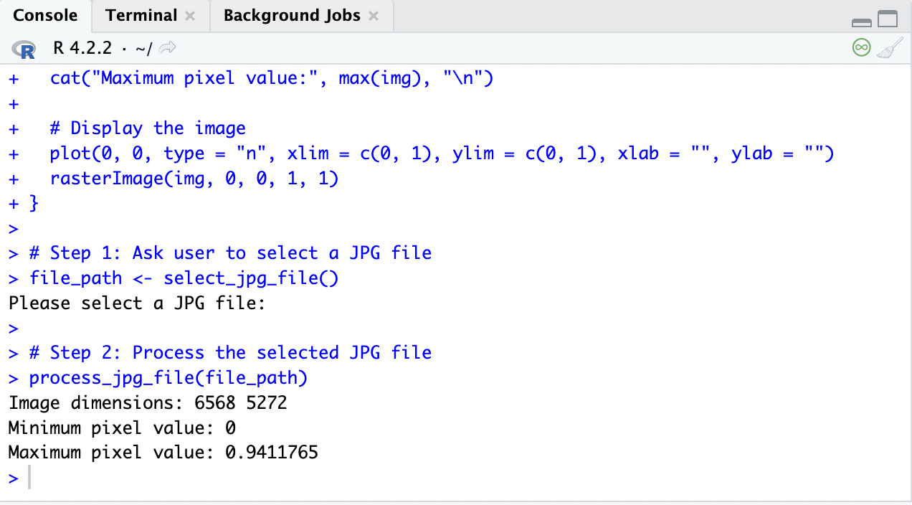

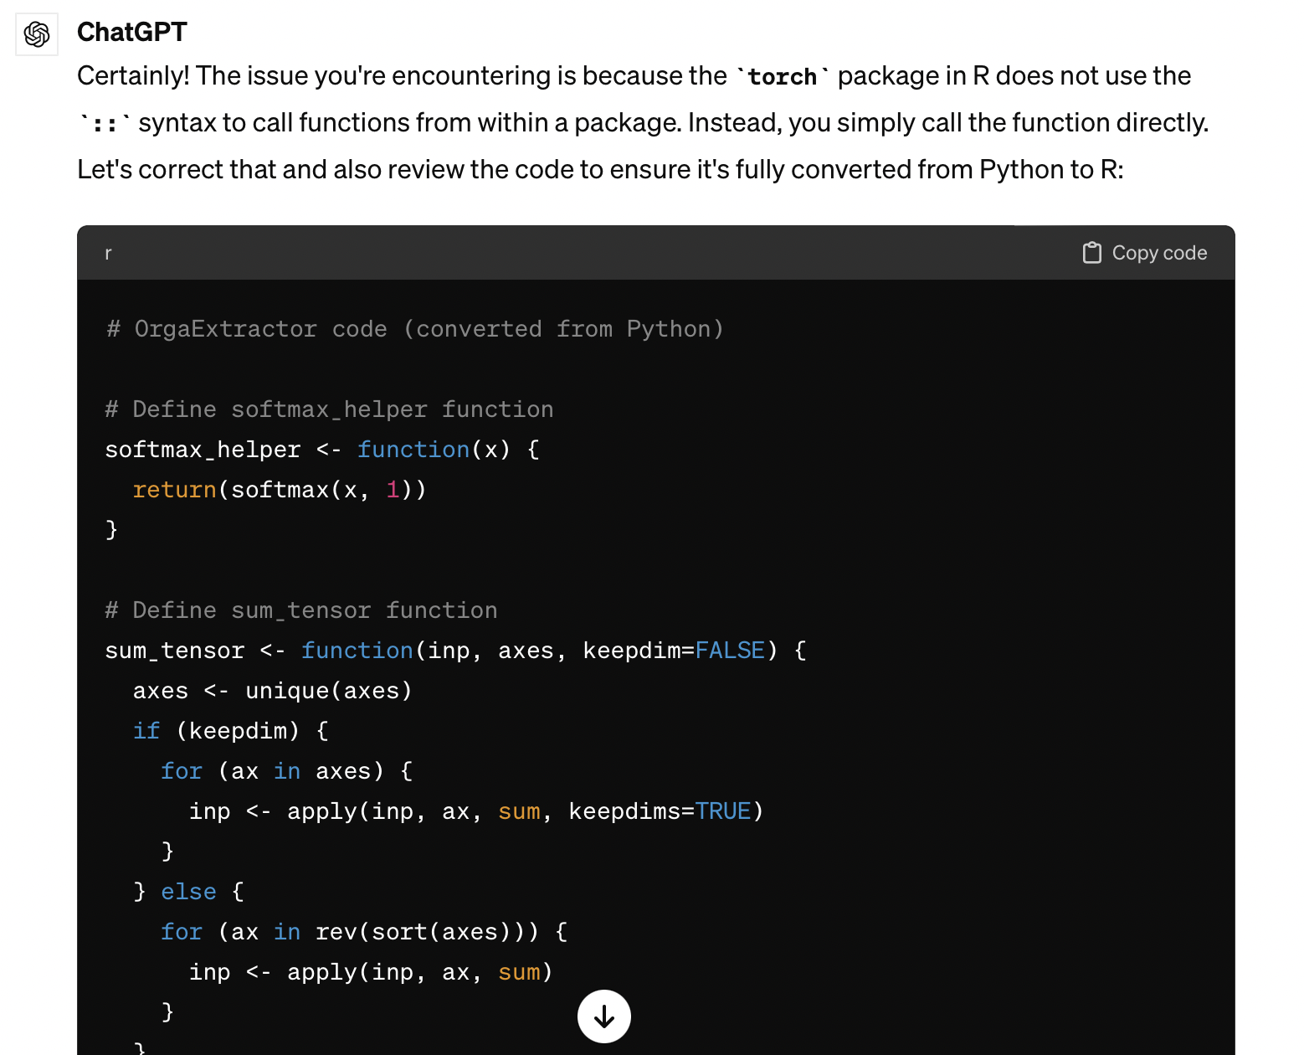
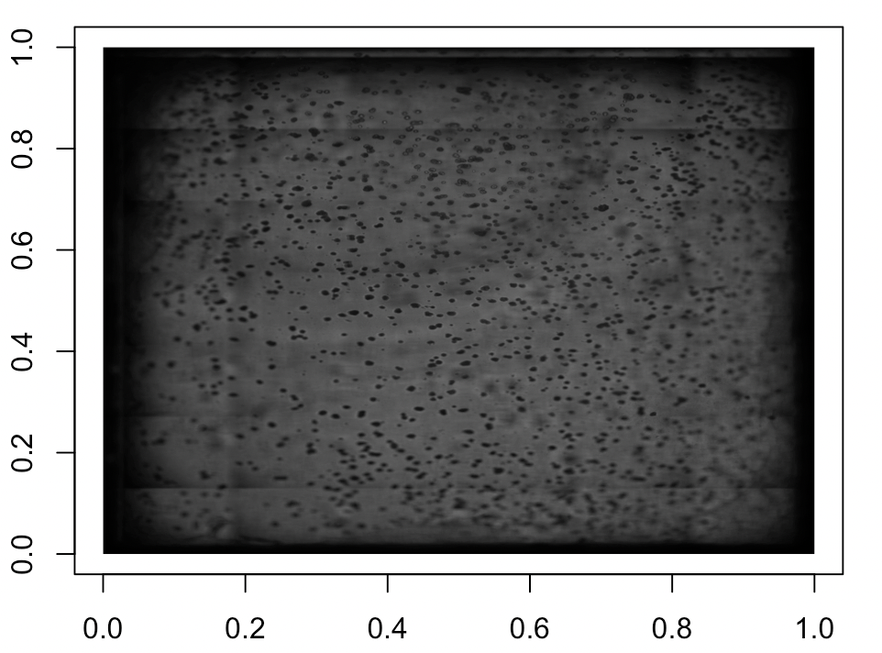
Step 5: Working Code!
HH

Slide 21
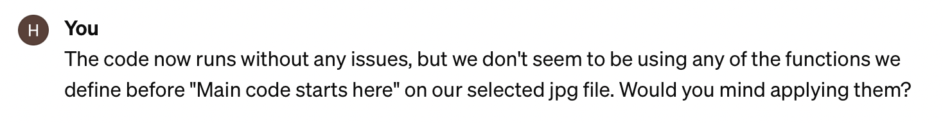
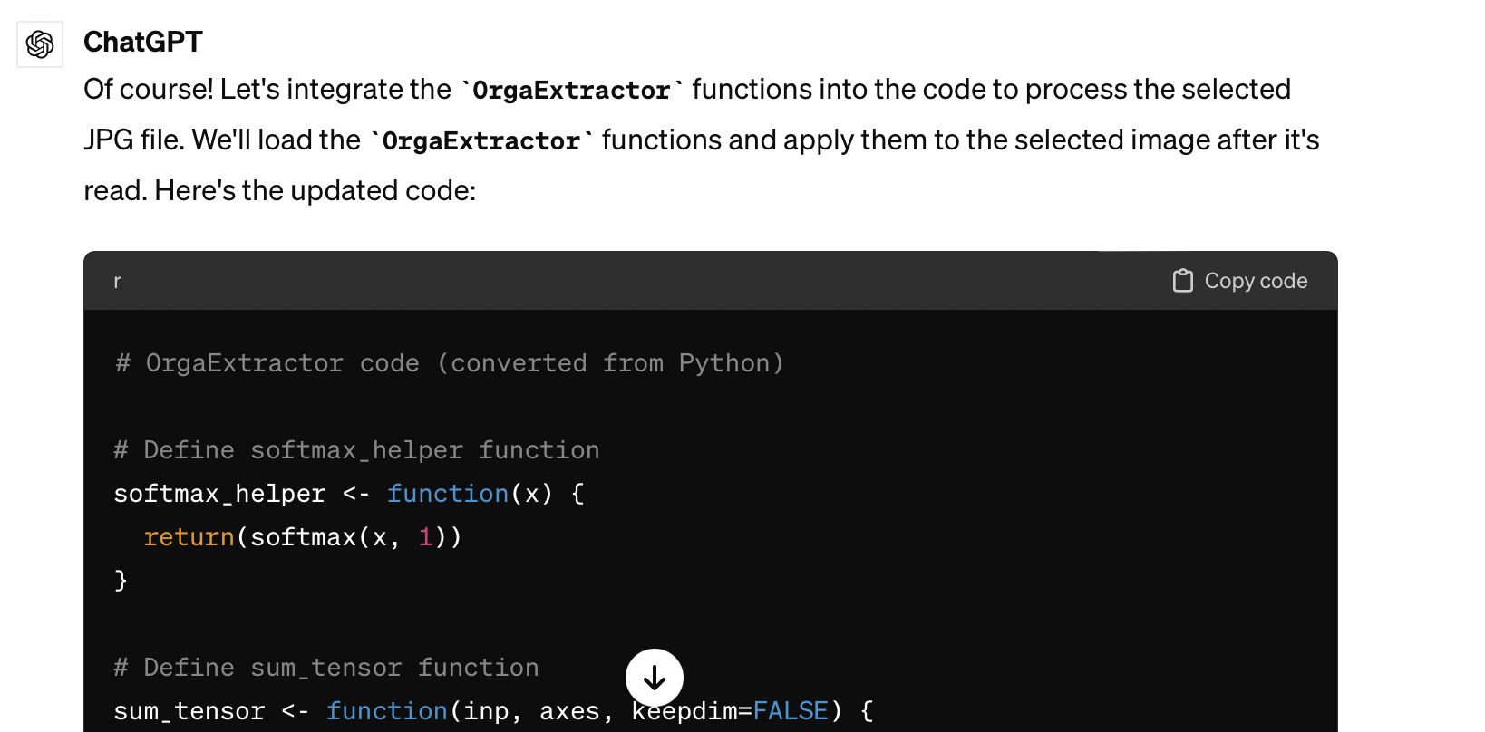
Adding Functionality
HH

Slide 22

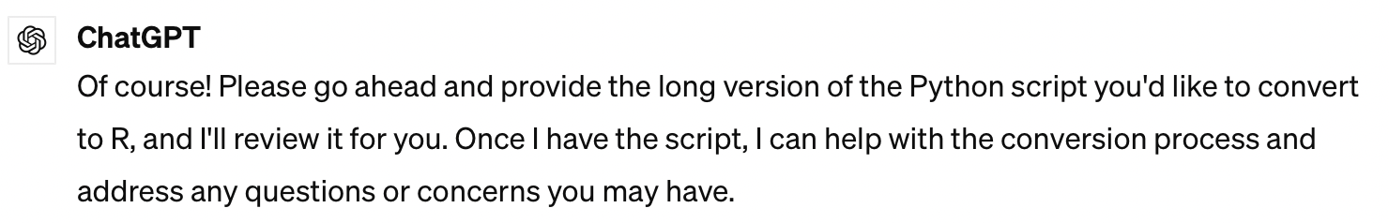
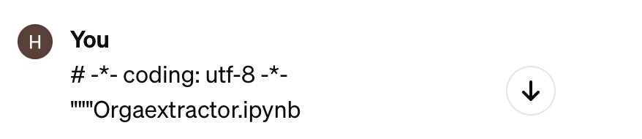
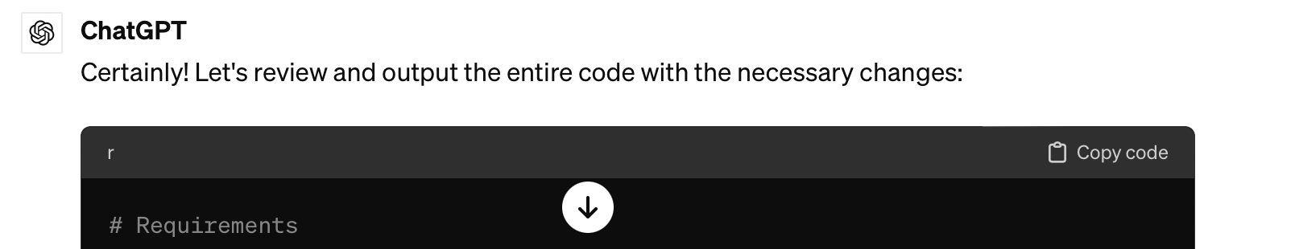
New Strategy: Convert First
HH
*A great deal of troubleshooting later
*Another great deal of troubleshooting happens here

Slide 23
Final Result
HH
# Requirements
library(argparse)
library(reticulate)
library(tidyverse)
library(torch)
library(torchvision)
library(data.table)
library(openxlsx)
#library(medpy)
library(imager)
#library(reticulate)
medpy <- import("medpy")
library(R6)
# Data path and result directory
data_path <- "/content/test"
result_dir <- "/content/result"
# Model Definition
Residual_block_3 <- R6Class(
"Residual_block_3",
inherit = nn_Module,
public = list(
initialize = function(in_channels, out_channels) {
super$initialize()
layers <- list(
nn_Conv2d(in_channels = in_channels, out_channels = out_channels,
kernel_size = 3, stride = 1, padding = 1, bias = TRUE),
nn_InstanceNorm2d(num_features = out_channels),
nn_ReLU(),
nn_Conv2d(in_channels = out_channels, out_channels = out_channels,
kernel_size = 3, stride = 1, padding = 1, bias = TRUE),
nn_InstanceNorm2d(num_features = out_channels),
nn_ReLU()
)
self$conv <- nn_Sequential(layers)
skips <- list(
nn_Conv2d(in_channels = in_channels, out_channels = out_channels,
kernel_size = 3, stride = 1, padding = 1, bias = TRUE),
nn_InstanceNorm2d(num_features = out_channels)
)
self$skip <- nn_Sequential(skips)
},
forward = function(x) {
x <- self$conv(x) + self$skip(x)
return(x)
}
)
)
Residual_block_7 <- R6Class(
"Residual_block_7",
inherit = nn_Module,
public = list(
initialize = function(in_channels, out_channels) {
super$initialize()
layers <- list(
nn_Conv2d(in_channels = in_channels, out_channels = out_channels,
kernel_size = 7, stride = 1, padding = 3, bias = TRUE),
nn_InstanceNorm2d(num_features = out_channels),
nn_ReLU(),
nn_Conv2d(in_channels = out_channels, out_channels = out_channels,
kernel_size = 7, stride = 1, padding = 3, bias = TRUE),
nn_InstanceNorm2d(num_features = out_channels),
nn_ReLU()
)
self$conv <- nn_Sequential(layers)
skips <- list(
nn_Conv2d(in_channels = in_channels, out_channels = out_channels,
kernel_size = 7, stride = 1, padding = 3, bias = TRUE),
nn_InstanceNorm2d(num_features = out_channels)
)
self$skip <- nn_Sequential(skips)
},
forward = function(x) {
x <- self$conv(x) + self$skip(x)
return(x)
}
)
)
Residual_block <- R6Class(
"Residual_block",
inherit = nn_Module,
public = list(
initialize = function(in_channels, out_channels) {
super$initialize()
self$x3 <- Residual_block_3$new(in_channels, out_channels)
self$x7 <- Residual_block_7$new(in_channels, out_channels)
self$conv <- nn_Conv2d(out_channels * 2, out_channels,
kernel_size = 1, stride = 1, padding = 0, bias = TRUE)
},
forward = function(x) {
x3 <- self$x3$forward(x)
x7 <- self$x7$forward(x)
x <- torch_cat(list(x3, x7), dim = 1)
x <- self$conv(x)
return(x)
}
)
)
ResUNet_MS <- R6Class(
"ResUNet_MS",
inherit = nn_Module,
public = list(
initialize = function() {
super$initialize()
self$pool <- nn_MaxPool2d(kernel_size = 2)
self$enc1_1 <- Residual_block$new(in_channels = 1, out_channels = 64)
self$enc2_1 <- Residual_block$new(in_channels = 64, out_channels = 128)
self$enc3_1 <- Residual_block$new(in_channels = 128, out_channels = 256)
self$enc4_1 <- Residual_block$new(in_channels = 256, out_channels = 512)
self$enc5_1 <- Residual_block$new(in_channels = 512, out_channels = 1024)
self$unpool5 <- nn_ConvTranspose2d(in_channels = 1024, out_channels = 512,
kernel_size = 2, stride = 2, padding = 0, bias = TRUE)
self$dec5_1 <- Residual_block$new(in_channels = 1024, out_channels = 512)
self$unpool4 <- nn_ConvTranspose2d(in_channels = 512, out_channels = 256,
kernel_size = 2, stride = 2, padding = 0, bias = TRUE)
self$dec4_1 <- Residual_block$new(in_channels = 512, out_channels = 256)
self$unpool3 <- nn_ConvTranspose2d(in_channels = 256, out_channels = 128,
kernel_size = 2, stride = 2, padding = 0, bias = TRUE)
self$dec3_1 <- Residual_block$new(in_channels = 256, out_channels = 128)
self$unpool2 <- nn_ConvTranspose2d(in_channels = 128, out_channels = 64,
kernel_size = 2, stride = 2, padding = 0, bias = TRUE)
self$dec2_1 <- Residual_block$new(in_channels = 128, out_channels = 64)
self$fc <- nn_Conv2d(in_channels = 64, out_channels = 1,
kernel_size = 1, stride = 1, padding = 0, bias = TRUE)
},
forward = function(x) {
enc1_1 <- self$enc1_1$forward(x)
pool2 <- self$pool$forward(enc1_1)
enc2_1 <- self$enc2_1$forward(pool2)
pool3 <- self$pool$forward(enc2_1)
enc3_1 <- self$enc3_1$forward(pool3)
pool4 <- self$pool$forward(enc3_1)
enc4_1 <- self$enc4_1$forward(pool4)
pool5 <- self$pool$forward(enc4_1)
enc5_1 <- self$enc5_1$forward(pool5)
unpool5 <- self$unpool5$forward(enc5_1)
cat5 <- torch_cat(list(unpool5, enc4_1), dim = 1)
dec5_1 <- self$dec5_1$forward(cat5)
unpool4 <- self$unpool4$forward(dec5_1)
cat4 <- torch_cat(list(unpool4, enc3_1), dim = 1)
dec4_1 <- self$dec4_1$forward(cat4)
unpool3 <- self$unpool3$forward(dec4_1)
cat3 <- torch_cat(list(unpool3, enc2_1), dim = 1)
dec3_1 <- self$dec3_1$forward(cat3)
unpool2 <- self$unpool2$forward(dec3_1)
cat2 <- torch_cat(list(unpool2, enc1_1), dim = 1)
dec2_1 <- self$dec2_1$forward(cat2)
x <- self$fc$forward(dec2_1)
return(x)
}
)
)
# Data Transformation
test_transform <- function(image) {
image <- TF$to_tensor(image)
image <- TF$normalize(image, 0.5, 0.5)
return(image)
}
# Dataset Class
Dataset <- R6Class(
"Dataset",
inherit = torch$utils$data$Dataset,
public = list(
initialize = function(data_dir) {
self$data_dir <- data_dir
lst_data <- list.files(self$data_dir)
lst_input <- lst_data[str_detect(lst_data, '^input')]
lst_input <- sort(lst_input)
self$lst_input <- lst_input
},
`__len__` = function() {
return(length(self$lst_input))
},
test_transform = test_transform,
`__getitem__` = function(index) {
p <- file.path(self$data_dir, self$lst_input[[index]])
if (grepl("npy$", p)) {
input <- np$load(p)
} else {
input <- imager::load.image(file.path(self$data_dir, self$lst_input[[index]]))
input <- imager::grayscale(input)
}
input <- input / 255.0
if (dim(input) == 2) {
input <- array(input, dim = c(dim(input), 1))
}
input <- self$test_transform(input)
return(input)
}
)
)
# Post-processing Functions
draw_contour <- function(args) {
kernel <- imager::as.cimg(imager::circle(7))
pred <- args / 255
pred[1090:1400 ] <- 0
o <- as.integer(pred)
contours <- imager::contours(as.cimg(o), levels = 0)
r <- imager::fill(as.cimg(o), contours)
o <- as.integer(r)
contours <- imager::contours(as.cimg(o), levels = 0)
return(list(img_contour = o, contours = contours, pp = r))
}
analysis <- function(img_contour, contours) {
info <- list()
c_im <- img_contour
for (i in seq_along(contours)) {
M <- imager::moments(as.cimg(contours[[i]]))
area <- M$m00
if (area == 0) next
cX <- as.integer(M$m10 / M$m00)
cY <- as.integer(M$m01 / M$m00)
radius <- sqrt(area / pi)
majorAxisLength <- 2 * radius
minorAxisLength <- 2 * radius
Eccentricity <- 1
Perimeter <- sum(imager::contour.length(contours[[i]]))
cv2$putText(c_im, as.character(i + 1), c(cX, cY), fontface = 1, fontscale = 0.5, color = "white", thickness = 1, lineType = 4)
tmp <- list(
Area = area,
Diameter = 2 * radius,
majorAxisLength = round(majorAxisLength, 2),
minorAxisLength = round(minorAxisLength, 2),
Eccentricity = Eccentricity,
Perimeter = round(Perimeter, 2)
)
info[[i + 1]] <- tmp
}
return(list(info = info, c_im = c_im))
}
# Parameter Definition
device <- "cuda"
torch::torch_save(file.choose(),"orgaextractor.pth")
pretrained_model <- torch::torch_load("orgaextractor.pth")
model <- ResUNet_MS$new()
model$load_state_dict(pretrained_model)
model$to(device)
model <- nn_DataParallel(module = model)
batch_size <- 2
fn_tonumpy <- function(x) {
return(x$to("cpu")$detach()$numpy()$transpose(0, 2, 3, 1))
}
fn_denorm <- function(x, mean, std) {
return((x * std) + mean)
}
fn_class <- function(x) {
return(1.0 * (x > 0.5))
}
# Data Loader
dataset_test <- Dataset$new(data_dir = data_path)
loader_test <- torch$utils$data$DataLoader(dataset_test, batch_size = batch_size, shuffle = FALSE)
num_data_test <- length(dataset_test)
num_batch_test <- ceiling(num_data_test / batch_size)
# Inference
for (data in loader_test) {
input <- data$to(device, dtype = torch$float)
with(torch$no_grad(), {
output <- model(input)
})
input <- fn_tonumpy(fn_denorm(input, mean = 0.5, std = 0.5))
output <- fn_tonumpy(fn_class(output))
for (j in seq_len(dim(input)[1])) {
id <- batch_size * (batch - 1) + j
imager::save.image(input[j, , , 1], file.path(result_dir, "png", paste0("input_", id, ".png")), type = "png")
imager::save.image(output[j, , , 1], file.path(result_dir, "png", paste0("output_", id, ".png")), type = "png")
o <- imager::load.image(file.path(result_dir, "png", paste0("output_", id, ".png")))
contours <- draw_contour(o)
analysis_info <- analysis(contours$img_contour, contours$contours)
df <- as.data.frame(do.call(rbind, analysis_info$info))
openxlsx::write.xlsx(df, file.path(result_dir, "analysis.xlsx"), sheetName = paste0("contour_", id))
imager::save.image(contours$img_contour, file.path(result_dir, "png", paste0("contour_", id, ".png")), type = "png")
imager::save.image(contours$pp, file.path(result_dir, "png", paste0("pp_", id, ".png")), type = "png")
}
}
After about 2 GB of downloads, 1 app installation, 1 R update, and 1 computer restart later, we get a 304 line code
We can run the code successfully to line 258, but the error we encountered there would have required a workspace wipe, accompanied by many downloads
However, we did add some new functionality to the code, allowing for file selection instead of hard coded file locations
We still consider this a success, and we could likely make a fully functional code with about 2-3 more hours of troubleshooting.
Roughly Here

Slide 24
Questions
Also, you should come to the handbell concert at 5:30 today in Roxy Grove Recital Hall!

Slide 25
References
Chatgpt0-3.5: An overview and limitations. Blocshop. https://www.blocshop.io/blog/chatgpt3-5-limitations
Coello CEA, Alimam MN, Kouatly R. Effectiveness of ChatGPT in Coding: A Comparative Analysis of Popular Large Language Models. Digital. 2024; 4(1):114-125. https://doi.org/10.3390/digital4010005
Shoji, J., Davis, R. P., Mummery, C. L., & Krauss, S. (2023). Global meta‐analysis of organoid and organ‐on‐chip research. Advanced Healthcare Materials. https://doi.org/10.1002/adhm.202301067
Wimmer RA, Leopoldi A, Aichinger M, Wick N, Hantusch B, Novatchkova M, Taubenschmid J, Hämmerle M, Esk C, Bagley JA, Lindenhofer D, Chen G, Boehm M, Agu CA, Yang F, Fu B, Zuber J, Knoblich JA, Kerjaschki D, Penninger JM. Human blood vessel organoids as a model of diabetic vasculopathy. Nature. 2019 Jan;565(7740):505-510. doi: 10.1038/s41586-018-0858-8. Epub 2019 Jan 16. PMID: 30651639; PMCID: PMC7116578.
Maramraju S, Kowalczewski A, Kaza A, Liu X, Singaraju JP, Albert MV, Ma Z, Yang H. AI-organoid integrated systems for biomedical studies and applications. Bioeng Transl Med. 2024 Jan 20;9(2):e10641. doi: 10.1002/btm2.10641. PMID: 38435826; PMCID: PMC10905559.
Joutsijoki H, Haponen M, Rasku J, Aalto-Setälä K, Juhola M. Error-Correcting Output Codes in Classification of Human Induced Pluripotent Stem Cell Colony Images. Biomed Res Int. 2016;2016:3025057. doi: 10.1155/2016/3025057. Epub 2016 Oct 26. PMID: 27847810; PMCID: PMC5101360.
Park, T., Kim, T.K., Han, Y.D. et al. Development of a deep learning based image processing tool for enhanced organoid analysis. Sci Rep 13, 19841 (2023). https://doi.org/10.1038/s41598-023-46485-2

Slide 26

Teaching an out-of-date system an up-to-date code
Kayla Haberman & Harrison Hall

